Slide 1

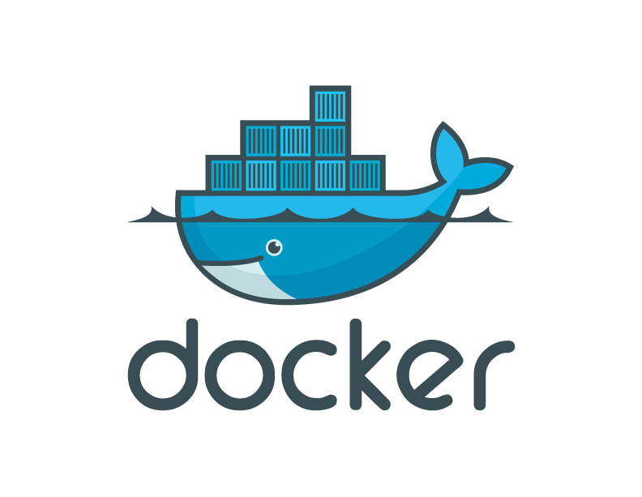
Docker for Test Automation
Rakesh Budugu

Slide 2
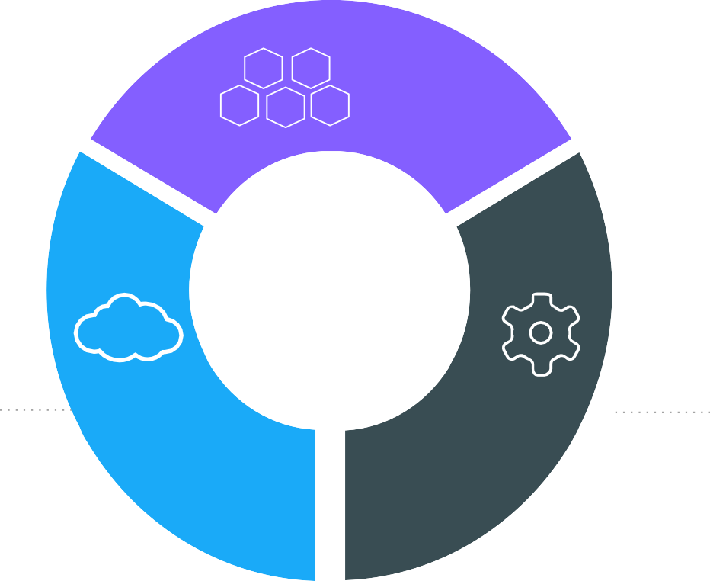
The IT Landscape is Changing
Apps
Cloud
DevOps

Slide 3

Movement in the cloud
Migrate workloads to cloud
80%
Portability across environments
Want to avoid cloud vendor lock-in
State of App development Survey: Q1 - 2016

Slide 4














Applications are transforming
~2000
Today
Loosely Coupled Services
Monolithic
Rapidly updated
Slow changing
Many Small
Servers or devices
Big Servers

Slide 5
Application Modernization
Application Code
Developer Issues:
Microservices: Break application into separate operations
Minor code changes require full re-compile and re-test
Application becomes single point of failure
Application is difficult to scale
12-Factor Apps: Make the app independently scalable, stateless, highly available by design

Slide 6
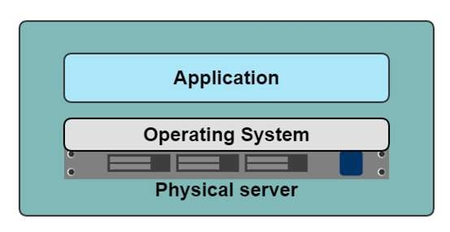
A History Lesson
In the Dark Ages
One application on one physical server

Slide 7
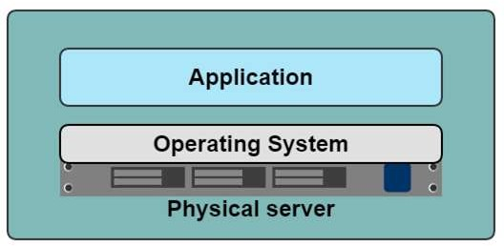
Historical limitations of application deployment
Slow deployment times
Huge costs
Wasted resources
Difficult to scale
Difficult to migrate
Vendor lock in

Slide 8
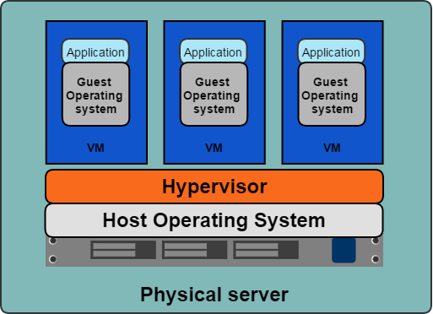
A History Lesson
Hypervisor-based Virtualization
One physical server can contain multiple applications
Each application runs in a virtual machine (VM)

Slide 9



Benefits of VMs
Better resource pooling
One physical machine divided into multiple virtual machines
Easier to scale
VMs in the cloud
Rapid elasticity
Pay as you go model

Slide 10
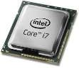
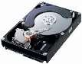
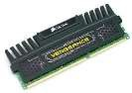
Limitations of VMs
Each VM stills requires
CPU allocation
Storage
RAM
An entire guest operating system
The more VMs you run, the more resources you need
Guest OS means wasted resources
Application portability not guaranteed

Slide 11
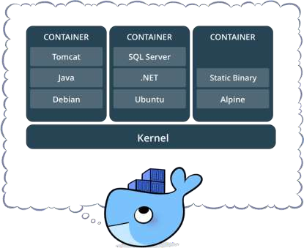
What is a container?
Standardized packaging for software and dependencies
Isolate apps from each other
Share the same OS kernel
Works with all major Linux and Windows Server

Slide 12
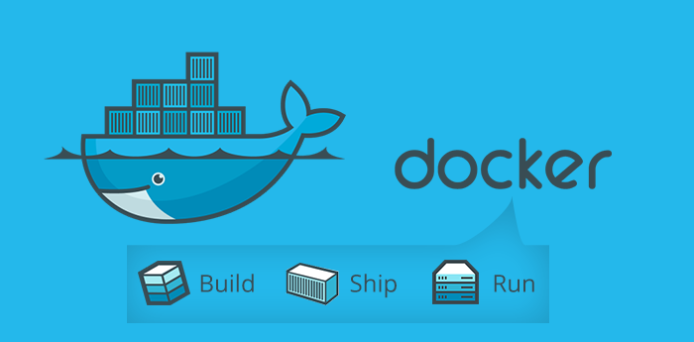

Slide 13
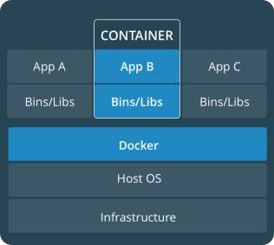
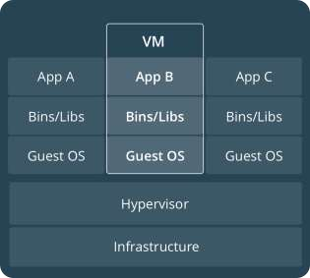
Comparing Containers and VMs
Containers are an app level construct
VMs are an infrastructure level construct to turn one machine into many servers

Slide 14
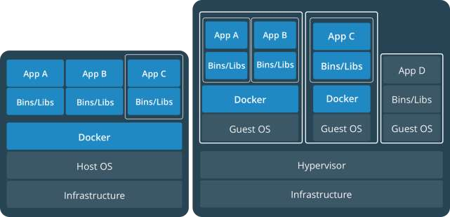
Containers and VMs together
PROD
DEV
Containers and VMs together provide a tremendous amount of
flexibility for IT to optimally deploy and manage apps.

Slide 15
Key Benefits of Docker Containers
Speed
No OS to boot = applications online in seconds
Portability
Less dependencies between process layers = ability to move between infrastructure
Efficiency
Less OS overhead
Improved VM
density

Slide 16

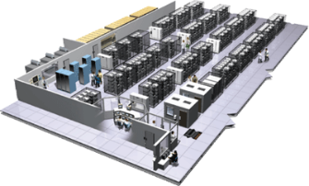
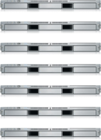
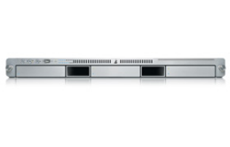
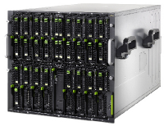

The Challenge
User DB
Static website
postgresql + pgv8 + v8
Queue
Analytics DB
nginx 1.5 + modsecurity + openssl + bootstrap 2
Do services and apps interact appropriately?
Redis + redis-sentinel
hadoop + hive + thrift + OpenJDK
Multiplicity of Stacks
Background workers
Web frontend
Python 3.0 + celery + pyredis + libcurl + ffmpeg + libopencv + nodejs + phantomjs
Ruby + Rails + sass + Unicorn
API endpoint
Python 2.7 + Flask + pyredis + celery + psycopg + postgresql-client
Production Cluster
Development VM
Public Cloud
Multiplicity of hardware environments
QA server
Can I migrate smoothly and quickly?
Disaster recovery
Customer Data Center
Contributor’s laptop
Production Servers

Slide 17
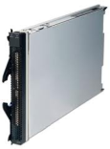
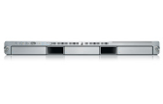
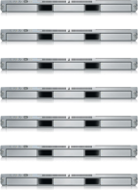

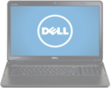
The Matrix From Hell
? | ? | ? | ? | ? | ? | ?
? | ? | ? | ? | ? | ? | ?
? | ? | ? | ? | ? | ? | ?
? | ? | ? | ? | ? | ? | ?
? | ? | ? | ? | ? | ? | ?
? | ? | ? | ? | ? | ? | ?
Static website
Web frontend
Background workers
User DB
Analytics DB
Queue
 | Development VM | QA Server | Single Prod Server | Onsite Cluster | Public Cloud | Contributor’s laptop | Customer Servers

Slide 18
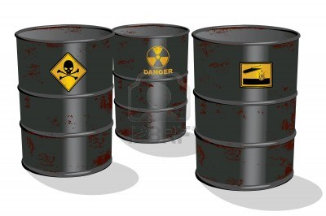
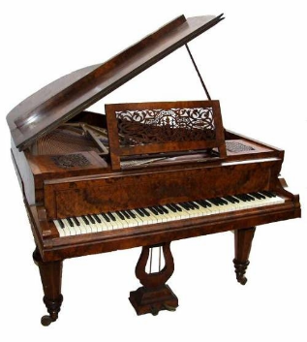

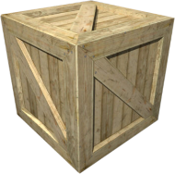
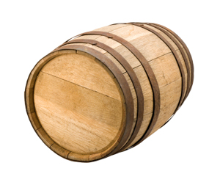
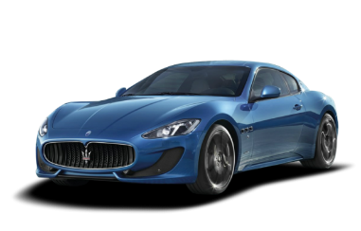
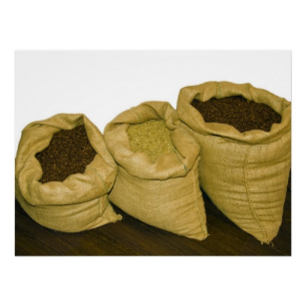



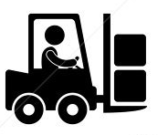
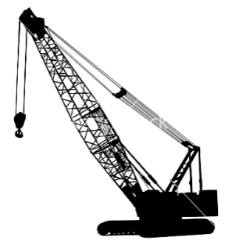
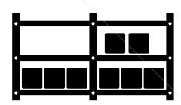

Cargo Transport Pre-1960
Do I worry about how goods interact (e.g. coffee beans next to spices)
Multiplicity of Goods
Multipilicity of methods for transporting/storing
Can I transport quickly and smoothly
(e.g. from boat to train to truck)

Slide 19
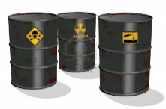

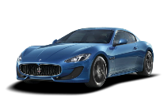


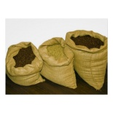






Also a matrix from hell
 | ? | ? | ? | ? | ? | ? | ?
 | ? | ? | ? | ? | ? | ? | ?
 | ? | ? | ? | ? | ? | ? | ?
 | ? | ? | ? | ? | ? | ? | ?
 | ? | ? | ? | ? | ? | ? | ?
 | ? | ? | ? | ? | ? | ? | ?

Slide 20



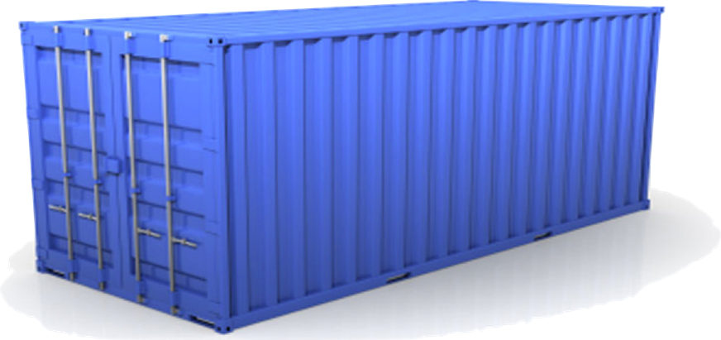
Solution: Intermodal Shipping Container
Do I worry about how goods interact (e.g. coffee beans next to spices)
Multiplicity of Goods
A standard container that is loaded with virtually any goods, and stays sealed until it reaches final delivery.
…in between, can be loaded and unloaded, stacked, transported efficiently over long distances, and transferred from one mode of transport to another
Can I transport quickly and smoothly
(e.g. from boat to train to truck)
Multiplicity of methods for transporting/storing

Slide 21
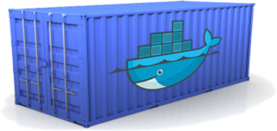
Docker is a shipping container system for code
Static website
User DB
Web frontend
Queue
Analytics DB
Do services and apps interact appropriately?
Multiplicity of Stacks
An engine that enables any payload to be encapsulated as a lightweight, portable, self-sufficient container…
…that can be manipulated using standard operations and run consistently on virtually any hardware platform
Multiplicity of hardware environments
Can I migrate smoothly and quickly
Development VM
QA server
Customer Data Center
Public Cloud
Production Cluster
Contributor’s laptop

Slide 22
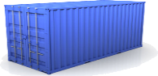
Docker eliminates the matrix from Hell
Static website
Web frontend
Background workers
User DB
Analytics DB
Queue
 | Development VM | QA Server | Single Prod Server | Onsite Cluster | Public Cloud | Contributor’s laptop | Customer Servers

Slide 23
Why Developers Care ?
Build once…run anywhere
A clean, safe, hygienic and portable runtime environment for your app.
No worries about missing dependencies, packages and other pain points during subsequent deployments.
Run each app in its own isolated container, so you can run various versions of libraries and other dependencies for each app without worrying
Automate testing, integration, packaging…anything you can script
Reduce/eliminate concerns about compatibility on different platforms, either your own or your customers.
Cheap, zero-penalty containers to deploy services? A VM without the overhead of a VM? Instant replay and reset of image snapshots? That’s the power of Docker

Slide 24
Why Dev-Ops Care?
Configure once…run anything
Make the entire lifecycle more efficient, consistent, and repeatable
Increase the quality of code produced by developers.
Eliminate inconsistencies between development, test, production, and customer environments
Support segregation of duties
Significantly improves the speed and reliability of continuous deployment and continuous integration systems
Because the containers are so lightweight, address significant performance, costs, deployment, and portability issues normally associated with VMs

Slide 25
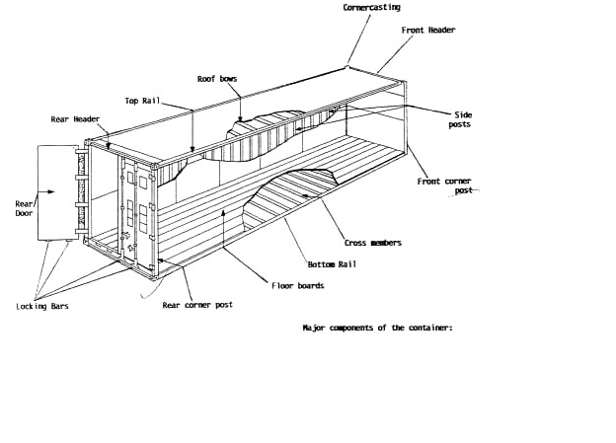
Why it works—separation of concerns
Dan the Developer
Worries about what’s “inside” the container
His code
His Libraries
His Package Manager
His Apps
His Data
All Linux servers look the same
Oscar the Ops Guy
Worries about what’s “outside” the container
Logging
Remote access
Monitoring
Network config
All containers start, stop, copy, attach, migrate, etc. the same way

Slide 26
More technical explanation
WHY
WHAT
Run everywhere
Regardless of kernel version (2.6.32+)
Regardless of host distribution
Physical or virtual, cloud or not
Container and host architecture must match
Run anything
If it can run on the host, it can run in the container
i.e. if it can run on a Linux kernel, it can run
High Level—It’s a lightweight VM
Own process space
Own network interface
Can run stuff as root
Can have its own /sbin/init (different from host)
<<machine container>>
Low Level—It’s chroot on steroids
Can also not have its own /sbin/init
Container=isolated processes
Share kernel with host
No device emulation (neither HVM nor PV) from host)
<<application container>>

Slide 27
Containers vs. VMs
App
A
App
A’
App
B
Containers are isolated,
but share OS and, where
appropriate, bins/libraries
Bins/
Libs
Bins/
Libs
Bins/
Libs
VM
Guest
OS
Guest
OS
Guest
OS
…result is significantly faster deployment, much less overhead, easier migration, faster restart
Guest
OS
Guest
OS
App A
App A’
App B
App B’
App B’
App B’
Container
Docker
Hypervisor (Type 2)
Bins/Libs
Bins/Libs
Host OS
Host OS
Server
Server

Slide 28
Why are Docker containers lightweight?
VMs
Containers
App
A
App
A
App
A’
App
A
App
A
App Δ
Bins/
Libs
Bins/
Libs
Bins/
Libs
Bins/
Libs
Bins/
Guest
OS
Guest
OS
Guest
OS
Guest
OS
Original App
(No OS to take
up space, resources,
or require restart)
Copy of
App
No OS. Can
Share bins/libs
Modified App
Copy on write capabilities allow
us to only save the diffs
Between container A and container
A’
VMs
Every app, every copy of an
app, and every slight modification
of the app requires a new virtual server

Slide 29




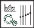
Docker Basics
Image
The basis of a Docker container. The content at rest.
Container
The image when it is ‘running.’ The standard unit for app service.
Engine
The software that executes commands for containers. Networking and volumes are part of Engine. Can be clustered together.
Registry
Stores, distributes and manages Docker images
Control Plane
Management plane for container and cluster orchestration

Slide 30
What are the basics of the Docker system?
Container A
Docker
Container
Image Registry
Push
Search
Pull
Source Code Repository
Run
Build
Dockerfile
For
A
Container A
Container B
Container C
Docker
Docker Engine
Host 1 OS (Linux)
Host 2 OS (Linux)

Slide 31
Changes and Updates
Docker
Container
Image Registry
App
A
Push
App Δ
Bins/
Libs
Bins/
Base
Container
Image
Container Mod A’
Container Mod A’’
App Δ
Update
App
A
Bins/
App
A’’
Bins/
Libs
Bins/
Libs
Bins/
Docker Engine
Docker Engine
Host is now running A’’
Host running A wants to upgrade to A’’. Requests update. Gets only diffs

Slide 32
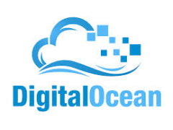
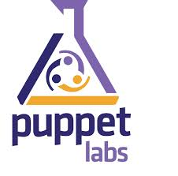
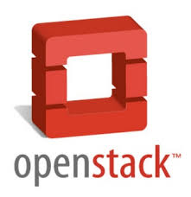
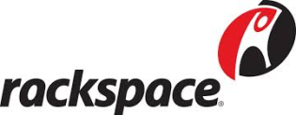



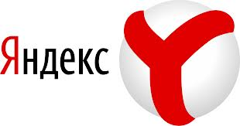

Ecosystem Support
Operating systems
Virtually any distribution with a 2.6.32+ kernel
Red Hat/Docker collaboration to make work across RHEL 6.4+, Fedora, and other members of the family (2.6.32 +)
CoreOS—Small core OS purpose built with Docker
OpenStack
Docker integration into NOVA (& compatibility with Glance, Horizon, etc.) accepted for Havana release
Private PaaS
OpenShift
Solum (Rackspace, OpenStack)
Other TBA
Public PaaS
Deis, Voxoz, Cocaine (Yandex), Baidu PaaS
Public IaaS
Native support in Rackspace, Digital Ocean,+++
AMI (or equivalent) available for AWS & other
DevOps Tools
Integrations with Chef, Puppet, Jenkins, Travis, Salt, Ansible +++
Orchestration tools
Mesos, Heat, ++
Shipyard & others purpose built for Docker
Applications
1000’s of Dockerized applications available at index.docker.io

Slide 33
Use Cases from Docker Community
Use Case | Examples | Link
Clusters | Building a MongoDB cluster using docker | http://bit.ly/1acbjZf
 | Production Quality MongoDB Setup with Docker | http://bit.ly/15CaiHb
 | Wildfly cluster using Docker on Fedora | http://bit.ly/1bClX0O
Build your own PaaS | OpenSource PaaS built on Docker, Chef, and Heroku Buildpacks | http://deis.io
Web Based Environment for Instruction | JiffyLab – web based environment for the instruction, or lightweight use of, Python and UNIX shell | http://bit.ly/12oaj2K
Easy Application Deployment | Deploy Java Apps With Docker = Awesome | http://bit.ly/11BCvvu
 | How to put your development environment on docker | http://bit.ly/1b4XtJ3
 | Running Drupal on Docker | http://bit.ly/15MJS6B
 | Installing Redis on Docker | http://bit.ly/16EWOKh
Create Secure Sandboxes | Docker makes creating secure sandboxes easier than ever | http://bit.ly/13mZGJH
Create your own SaaS | Memcached as a Service | http://bit.ly/11nL8vh
Automated Application Deployment | Multi-cloud Deployment with Docker | http://bit.ly/1bF3CN6
Continuous Integration and Deployment | Next Generation Continuous Integration & Deployment with dotCloud’s Docker and Strider | http://bit.ly/ZwTfoy
 | Testing Salt States Rapidly With Docker | http://bit.ly/1eFBtcm
Lightweight Desktop Virtualization | Docker Desktop: Your Desktop Over SSH Running Inside Of A Docker Container | http://bit.ly/14RYL6x

Slide 34
Docker Installation

Slide 35
Play with Docker A free Docker playground

Slide 36
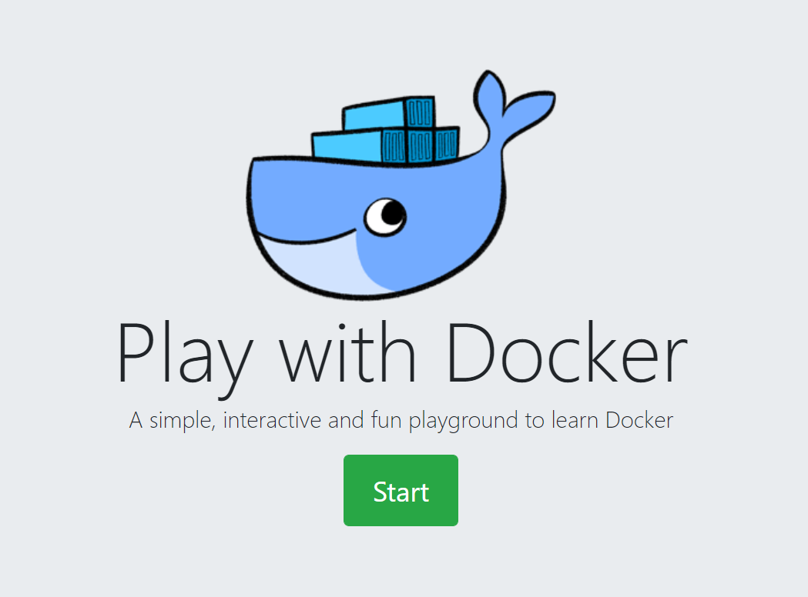
https://labs.play-with-docker.com/

Slide 37
Docker for Mac/Windows Developing with Docker on your laptop

Slide 38
Get it from Docker-hub and install:
Windows
https://hub.docker.com/editions/community/docker-ce-desktop-windows/
MacOS
https://hub.docker.com/editions/community/docker-ce-desktop-mac/

Slide 39
Docker on Linux Where it all began

Slide 40

Follow the instructions:
Distribution - Ubuntu
https://docs.docker.com/engine/install/ubuntu/
OR
$ wget -qO- https://get.docker.com/ | sh

Slide 41
Docker Architecture

Slide 42


Slide 43
Docker Engine
Docker Engine is a client-server application with these major components:
A server which is a type of long-running program called a daemon process (the dockerd command).
A REST API which specifies interfaces that programs can use to talk to the daemon and instruct it what to do.
A command line interface (CLI) client (the docker command).

Slide 44
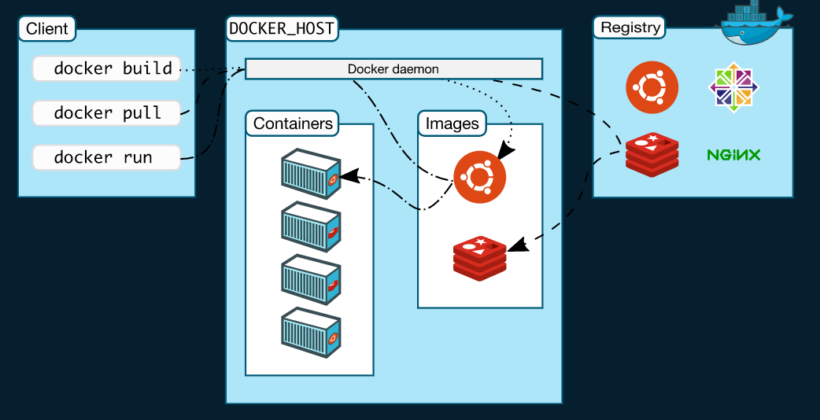

Slide 46
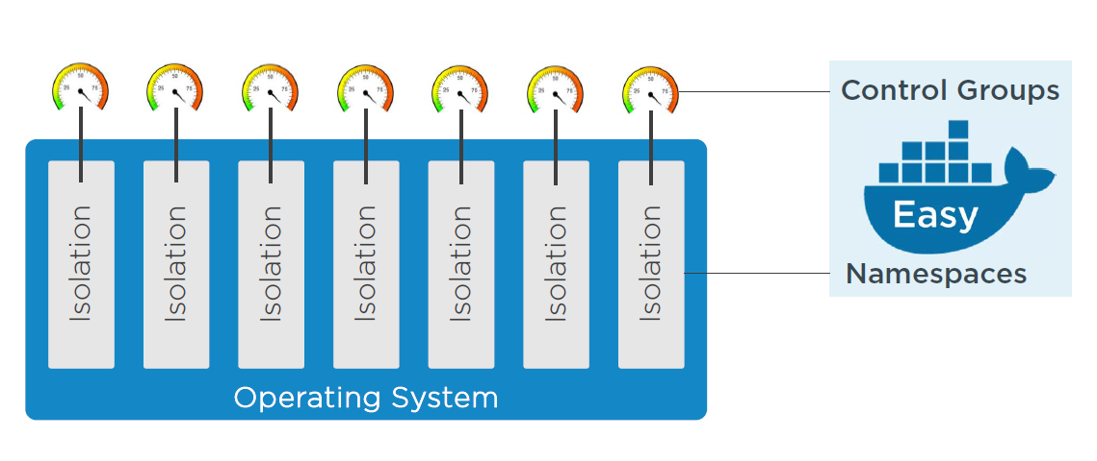
The Underlying Technology
Docker is written in Go and takes advantage of several features of the Linux kernel to deliver its functionality.
Namespaces
Control Groups
Union file systems
Container Format

Slide 47
Namespaces
Docker uses a technology called namespaces to provide the isolated workspace called the container. When you run a container, Docker creates a set of namespaces for that container.
These namespaces provide a layer of isolation. Each aspect of a container runs in a separate namespace and its access is limited to that namespace.
Docker Engine uses namespaces such as the following on Linux:
The pid namespace: Process isolation (PID: Process ID).
The net namespace: Managing network interfaces (NET: Networking).
The ipc namespace: Managing access to IPC resources (IPC: InterProcess Communication).
The mnt namespace: Managing filesystem mount points (MNT: Mount).
The uts namespace: Isolating kernel and version identifiers. (UTS: Unix Timesharing System).

Slide 48

Others
Control Groups - Docker Engine on Linux also relies on another technology called control groups (cgroups). A cgroup limits an application to a specific set of resources.
Union File Systems - Union file systems, or UnionFS, are file systems that operate by creating layers, making them very lightweight and fast. Docker Engine uses UnionFS to provide the building blocks for containers.
Container Format - Docker Engine combines the namespaces, control groups, and UnionFS into a wrapper called a container format. The default container format is libcontainer.

Slide 49
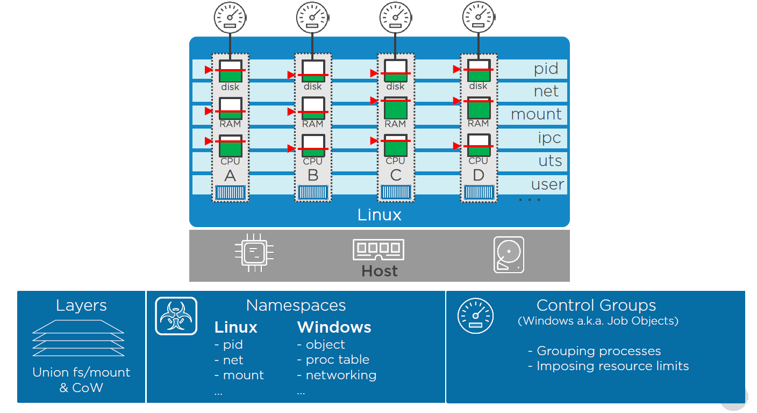

Slide 50
Initial Docker Architecture

Slide 51
Current Docker Architecture

Slide 52
Components Interaction

Slide 53
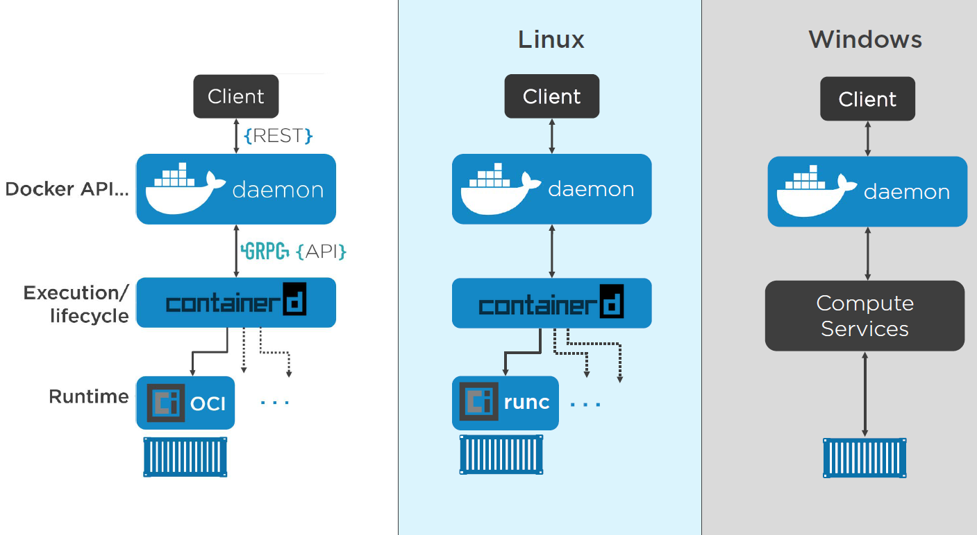

Slide 54
Understanding Docker Images

Slide 55
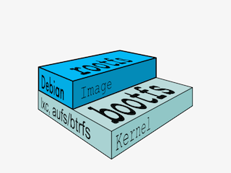
What is an Image ?
Image = files + metadata
These files form the root filesystem of our container.
The metadata can indicate a number of things, e.g.:
the author of the image
the command to execute in the container when starting it
environment variables to be set
etc.
Images are made of layers, conceptually stacked on top of each other.
Each layer can add, change, and remove files and/or metadata.
Images can share layers to optimize disk usage, transfer times, and memory use.

Slide 57
Images and Layers

Slide 58
Images and Layers

Slide 59
Images and Layers

Slide 60
Working with Docker Containers

Slide 61
Containerizing Applications

Slide 63
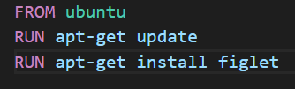
Dockerfile
Dockerfile is a build recipe for Docker.
It contains a series of instructions telling Docker how an image is constructed.
The docker build command builds an image from a Dockerfile.
Example:

Slide 64


Slide 65


Slide 66


Slide 67


Slide 68


Slide 69


Slide 70


Slide 71


Slide 72


Slide 73


Slide 74


Slide 75
Docker Networking

Slide 76
The Docker Engine supports many different network drivers.
The built-in drivers include:
bridge (default)
none
host
Overlay(multi-host)
The driver is selected with docker run --net ....

Slide 77
Docker Volumes

Slide 79
Docker Compose Building multi-container applications with Docker

Slide 80

The Docker Compose is used to run multi-container applications.
Each container will run a stand-alone application and it can communicate with other containers present in the same host.

Slide 81
Docker Swarm Container orchestration

Slide 82
Multi -host

